Slide 1
IMAGE PROCESSING
By
Viral 3

Slide 2
10-Image manipulations with PIL(Crop and Negating)
PIL provides us with many functions to manipulate an image; for example, using a point transformation to change pixel values or to perform geometric transformations on an image.
CROP AN IMAGE
NEGATING AN IMAGE
***Providing the correct path to the images on the disk***

Slide 3
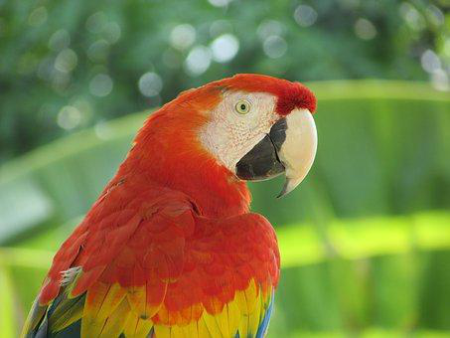
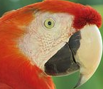
Cropping an image
We can use the crop() function with the desired rectangle argument to crop the corresponding area from the image
***Providing the correct path to the images on the disk***

Slide 4
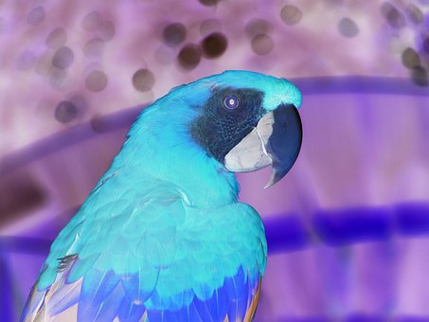
Negating an image
We can use the point() function to transform each pixel value with a single-argument function. We can use it to negate an image, as shown in the next code block. The pixel values are represented using 1-byte unsigned integers, which is why subtracting it from the maximum possible value will be the exact point operation required on each pixel to get the inverted image:
***Providing the correct path to the images on the disk***

